Slide 1
Handling Large Classes
Shivani Talatam Zamaan Bawa Pritul Dave

Slide 2
The Issue
A Bloater:
Code smells where the structure has grown large.
Hard to read and understand.
Large class:
When a class has many lines or methods.

Slide 3
What is a Large Class Code Smell?
A class that has grown to become very large.
“-ilities” that decrease:
Readability
Understandability
Enjoyability

Slide 4
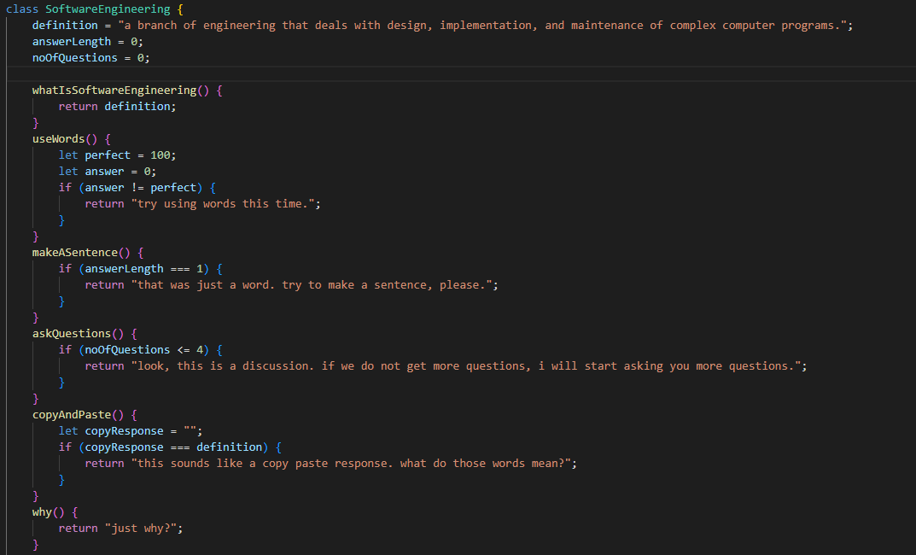
Here’s an example!

Slide 5
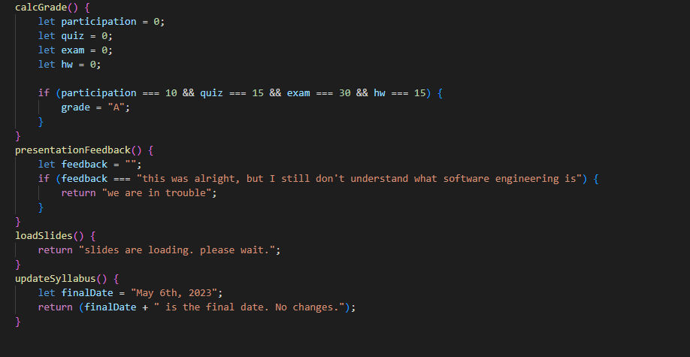
Here’s an example!

Slide 6

How do we solve this problem?

Slide 7
Refactoring!
We can extract the class.
We can create smaller classes.
Divide the class into classes that are relevant to the methods.
A large, unorganized class is not ideal.
Having smaller and more organized classes is much more efficient.
Notes:
The solution for this problem is refactoring and the solution is also very simple. What we gonna do is we will divide the large class into smaller sub classes but not only just subclasses but much more in an organized form. So this will makes the codebase efficient and easy to navigate.

Slide 8
Extracting the class
It can improve:
Here come the “ilities”
Readability
Understandability
Enjoyability
Notes:
So now just imagine you are reading a large book and text is so confusing that it barely makes sense. So it is frustrating right? Same way with the software also, If a software has good readability and unders then developers will enjoy developing/maintaining the software

Slide 9
Before the changes

Slide 10
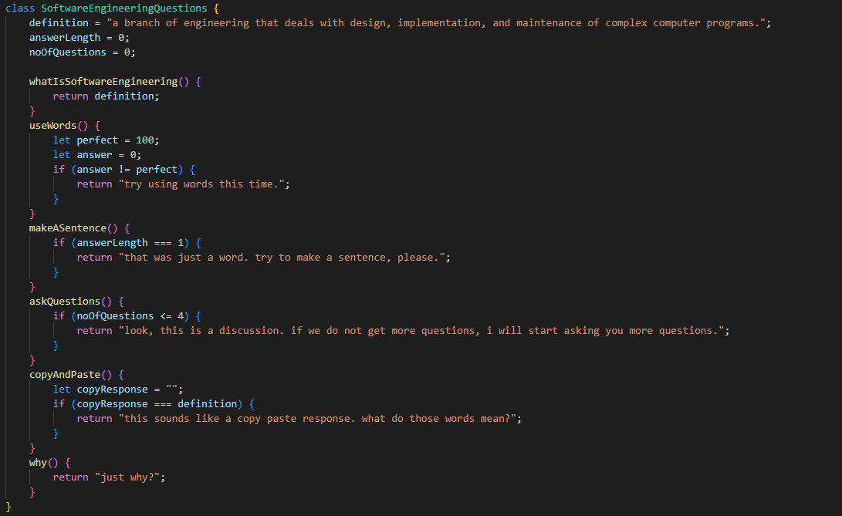
After the changes

Slide 11
Before the changes

Slide 12
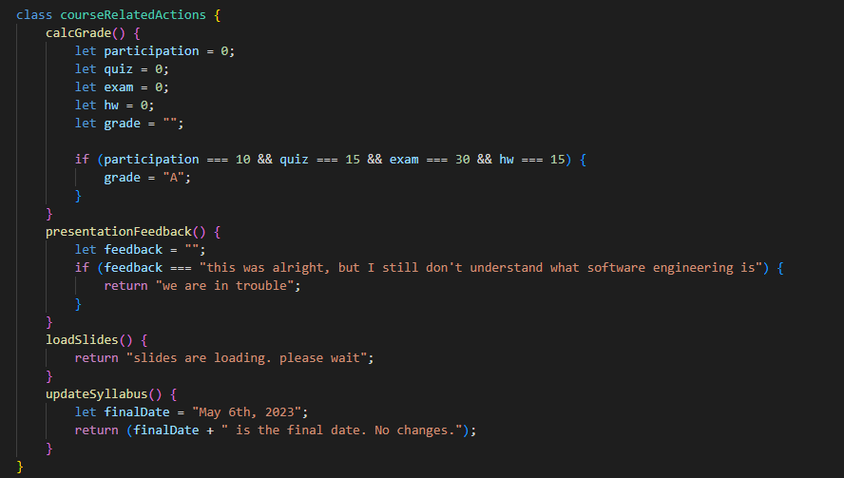
After the changes

Slide 13
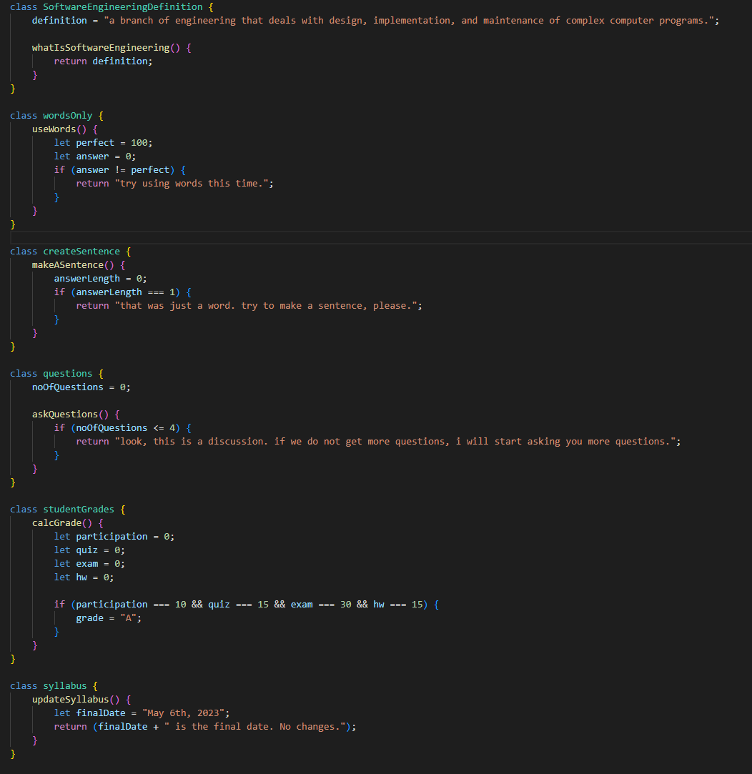
Pros and Cons
Pros:
Organized.
Much easier to read.
Easier to modify.
Easy to encapsulate.
Cons:
Too much of something is bad.
Increased complexity & dependency.
Development, maintenance time and efforts all increase.
Notes:
So if you see over here, the classes are much more organized ad readable and they can easily be encapsulated.
However, the problem is that too many of classes can increase complexity and dependency. Moreover, development and maintenance time + efforts increases

Slide 14
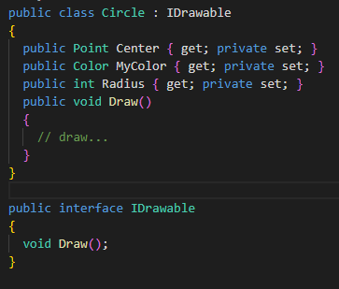
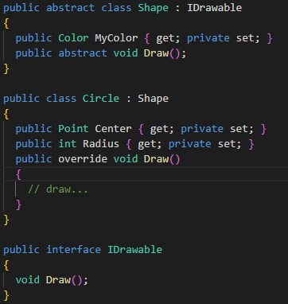
Another solution
Extract the superclass/subclass.
Before
After

Slide 15
Comparisons
Long methods:
Similar to large classes, but when we have methods that are very large.
The best way to refactor is via extracting the method:
Divide the method into smaller and more understandable methods.

Slide 16
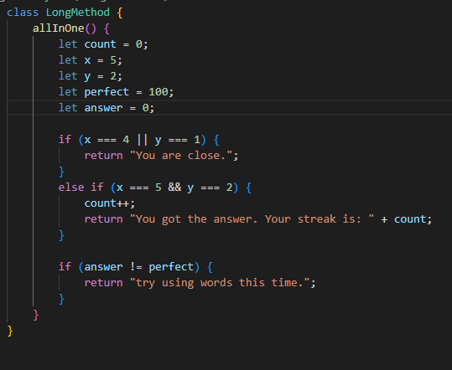
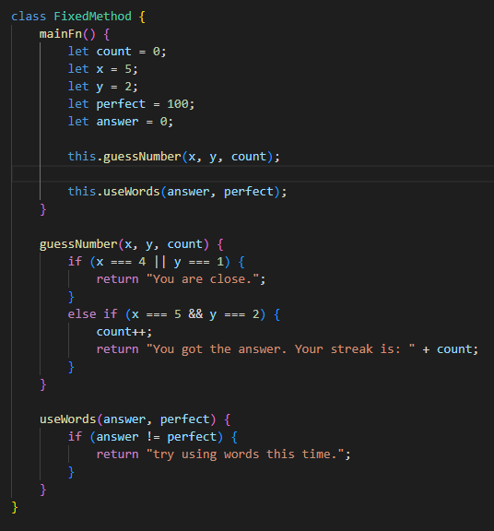
An example of a long method
Before
Before
After

Slide 17
Conclusion
A large class code smell is a bloater that happens over time.
It can be resolved by extracting the class into:
Smaller and more organized classes.
Moderation is key.
This will improve:
Readability
Understandability
Enjoyability
All the “ilities”

Slide 18
Questions:
What is a bloater?
What happens if we don’t ask enough questions?
When answering a question, should we use one word or many words?
Lastly, what can be a drawback of extracting large classes?

Slide 19
Thank you!

